Slide 1
CHAPTER ONE
INTRODUCTION OF STATISTICS
Definition:
Statistics is concerned with scientific methods for collecting, organizing, summarizing, presenting, and analyzing data as well as with drawing valid conclusions and making reasonable decisions on the basis of such analysis.

Slide 2
Population:
The totality of all elements under the study or discussion is called population.
Example: If we measure the heights and weights of a group of person then it is called population.
Populations are two types: (i) Finite population;
(ii) Infinite population.
Finite population: A Population is called finite population if its elements are countable. Example: Number of students in a university.
Infinite population: A population is called infinite population if its elements are not countable.
Example: Number of fishes in the Bay of Bengal.

Slide 3
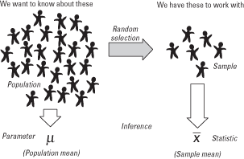
Sample: A representative part of population is called sample Or a part of the population is called sample.
Example: If we measure the height and weight of IIUC student, then that of the CSE/EEE/ETE department student are sample.
# Difference between a population and a sample

Slide 4
Variable
Any phenomenon which varies from individual to individual is called variable. Variables are represented by symbols (e.g., x, y, or z).
For example Age, weight, height, sex, income and expenses, country of birth, capital expenditure, class grades, eye colour and vehicle type are examples of variables.
Variables can be classified as qualitative (categorical) or quantitative (numeric).
Qualitative variable:
A variable which cannot be expressed as numerically is called qualitative (categorical) variable.
Examples: Hair color, gender, field of study, college attended, political affiliation, status of disease infection, sex, business type, eye colour, religion and brand.

Slide 5
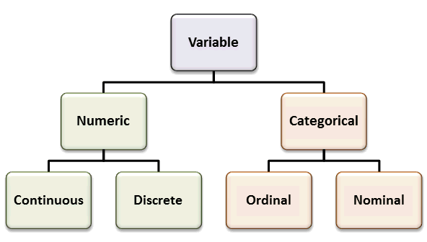
Quantitative variables can be further classified as discrete or continuous.
Discrete variable:
A variable is called discrete variable if it can take only isolated (Whole) values. Examples of discrete variables include the number of registered cars, number of business locations, and number of children in a family, all of which measured as whole units (i.e. ,1, 2, 3 cars).
Continuous variable:
A variable is called continuous variable if it can take any values between certain limits. i.e. Observations can take any value between a certain set of real numbers. Examples of continuous variables include height, time, age, and temperature.
N.B: Every continuous variable are discrete but every discrete variable are not continuous.
Figure of different types of variable:

Slide 6
DATA
The raw materials of statistics consists of observations usually obtain by some process of counting or measurement, referred to collectively as data.
Types of Data
Primary Data:
Primary data are those which are collected afresh and for the first time and thus happen to be original in character. Such data are published by the authorities who themselves for their collection.

Slide 7
Methods of collecting primary data:
Personal Interview method (Schedule method):
Mailed questionnaire method:
Observation method:
Telephone Interview method:
Qualitative Data Collection Techniques:
Unstructured Interviews
Focus Group Discussion (FGD)
Observations
Document Study
Content Analysis
Case Study
Panel Study
Delphi method

Slide 8
Secondary data:
When an investigator (researcher) uses the data which has already been collected by others.

Slide 9
Important Sources of Secondary Data:
Internal: Monthly abstract of statistics, Statistical year book, Different ministries, Central bank, BBS, BIDS, NIPORT, BARI, BRRI, BMD, BFRI, BJMC, BTMC, BENBAISE, Population council , Internet, etc.;
International: UNO, WHO, UNESCO, FAO, ILO, IMF, UNICEF, UNFPA, ICDDR’B, IOM, IRRI, UNCTAD, Internet, World Bank, Statistical Year Book- published by the Statistical Office of the UN etc.;
Other sources: Journals, Reports, Historical documents, Professional bodies, Biographies etc.

Slide 10
Scrutiny of secondary Data/ Precautions should be taken before using secondary data:
Secondary data must be used with utmost care because secondary data may be erroneous, inadequate or substitutes. Even if there are errors, secondary data may not be suitable and adequate for the purpose of the study. Hence before using secondary data an investigator should examine the following aspects:

Slide 11
Suitability: The researcher should satisfy himself that the data contained in the publication will be suitable for his study.
Reliability: the reliability of secondary data can be ascertained from the collecting agency, mode of collection and time period of collection.
Adequacy: the source of data may be suitable and reliable but the data may not be adequate. Therefore, before using the secondary data it should be examined whether the data are adequate for the study.
Accuracy: Finally, the user must be satisfied about the accuracy of the secondary data for his research study.

Slide 12
Disadvantage:
Because secondary data have been collected for purpose other than problem at hand, their usefulness to the current problem may be limited in several important ways including relevance and accuracy. The objective, nature and methods used to collect the secondary data may not be appropriate to the present situation. Also secondary data may be lacking in accuracy and they may not be completely current and dependable. Therefore, before using secondary data, it is important to evaluate them on these factors.

Slide 13
Relationship between computer and statistics
The development of statistics has been closely related to the evaluation of computer. Statistics is a form of data processing. The computer can process large amount of data quickly and accurately. For processing the large amount of data some of the important statistical packages that have been used are – SPSS, SAS, STATA, S-plus and MINITAB.

Slide 14
In any survey the information are collected according to some predetermined question. A set of question for any survey constitutes the questionnaire.
Characteristics of a good Questionnaire
Question should be logically arranged.
Question should be as few as possible.
Question should be easy to understand.
Question should not be of multiple meaning.
Question should be capable of objective answer.
Question should be well designed.
Personal question should be avoided.

Slide 15
Types of questions:
There are many ways to phrase the questions. We may categories two best types of questions according to amount of freedom respondents are given in answering the questions:
a. Open-ended (Unstructured):
b. Fixed alternative question:
A structured question may be MCQ or Dichotomous.
a. Multiple Choice Questions (MCQ)
b. Dichotomous Question:
Pre-coded and post coded question

Slide 16
Measurement and Scaling
A measurement is obtained when a variable is measured on experimental unit. Measurement means assignment of numbers or other symbols to characteristics of objects according to certain pre-specified rules.
Scaling may be considered as an extension of measurement. Measurement is the actual assignment of a number to each respondent. Scaling is the process of placing the respondents on a continuum with respect to their attitude toward the object/item/institution. Scaling involves creating a continuum upon which measured object are located. The generation of continuum upon which the measured objects are located is called scaling.

Slide 17
MEASUREMENT AND SCALING
Scales of Measurement
Primary Scales
Comparative Scales
Non-Comparative Scales
Qualitative
Quantitative
Paired
Comparison
Rank Order
Constant Sum
Q-Sort
Nominal
Ordinal
Interval
Ratio
Likert Scale
(5points)
Semantic differentials
(7points)
Staple (10points)

Slide 18
Comparative Study of Primary Scales of Measurement:
Scale of Measurement | Mathematical Operations | Examples
Nominal | Counting | Gender, Religion, Color
Ordinal | Counting & Ranking | Economic Status, Farm size
Interval | Counting, Ranking, Addition & Subtraction | IQ test scores, Temperature, SAT scores, Calendar Time
Ratio | Counting, Ranking, Addition, Subtraction, Multiplication & Division | Age, Investments, Income, Expenditure, Family Size

Slide 19
Classification: Classification is the first statistical technique to condense the raw data. It is the process of arranging data in different groups or classes according to their affinities.
Tabulation: Tabulation is a logical and systematic arrangement of statistical data in raws and columns.
Frequency:
The number of times that a given value occurs into each group / class is known as frequency.
For example, if four students have a score of 80 in mathematics, and then the score of 80 is said to have a frequency of 4. The frequency of a data value is often represented by f.
Frequency distribution
Arrangement of observations according to frequencies is called frequency distribution.

Slide 20
SAMPLE QUESTIONNAIRE:
Questionnaire on “Socio-Economic background and academic performance Of IIUC students”.
1.Students Name: | ID:
2. Semester | 3. Department:
4. Mobile number (if possible): | 5.Gender: (a) male, (b) Female
6. Age:………………….. | 7. Religion: (a) Islam (b) Hindu (C)Others
8. Home District: | 9. Number of brothers and sisters:…………
10. What is your serial number as a son/daughter of your parents? (a) First, (b) second, (c) third,(d) fourth (e) ___________ | 11.Areas of your School at SSC or equivalent level : (a) city, (b) small town (c) village
12. Areas of your School at HSC or equivalent level : (a) city, (b) small town (c) village | 13. Did you pass (a) SSC/HSC, (b) O-level/A-level,(c) Madrasa qualifications (d) others
14. SSC and HSC (or equivalent) GPA: SSC:_____ and HSC……….. | 15. Father’s Education: (a) No education (b) Primary, (c) Secondary, (d) Higher Secondary (e) University.
16. Mother’s Education: (a) No education (b) Primary, (c) Secondary, (d) Higher Secondary (e) university. | 17. What is ( or was ) your father’s occupation: (a) Agriculture (b) Business (c) Service (d) teacher and (e) Others.
18. What is ( or was ) your mother’s occupation: (a) Housewife (b) Business (c) Service (d) teacher and (e) Others. | 19. Your father and mother monthly income:………………..

Slide 21
20. Economic status of your family:(a) Poor, (b) lower middle class (c) middle class, (d) higher middle class, (e)rich | 21.Behind Choosing IIUC: (a) Islamic (b) Tuition (c) Safety and distance (d) Faculty (e)Good private university(f) Scholarship (g) others.
22. How you got information about IIUC: (a) Advertisement, (b) Faculty (c) friends/relatives, (d) internet | 23.While attending university, I live: (a) In a hall (b) At home/ Family (c) Mess (d) Relative/friends (e) others
24. Approximately, what was your grade average in your final year of IIUC:…………..out of 4.00. | 25. Do you discuss your grades with your guardian? (a) Yes (b)No
26.Compared to my friends at university, I am, on an academic basis, performing:(a) Better (b) Same (c)Worse | 27. How often did you miss classes: (a) Always (b) Sometimes (C) Never (d) Once every week?
28. Usually I study: (a) Library (b) Class (c) my room (d) If other please Specify:…………. | 29. Generally, I study…………….hours daily.
30.Are you satisfied in IIUC academic system: (a) yes (b) No. | 31. Do you seem that tuition fee is higher in IIUC? (a) yes (b) No.
32. What's your dream Career? (a) Subject related job(b) Teacher (c) Banker (d) service (e) others.
THANK-YOU

Slide 22
Construction of a frequency distribution:
Following are the steps for the construction of a frequency distribution:
1. Class limits/Range: The class limits are the lowest and highest values that can be included in the class.
2. Number of classes: K = 1+3.322 log₁₀^{N} where N is the number of observations,
3. Class interval: C.I = Range /K where, Range = H.V - L.V.
4. Class frequency/Tally: The number of observations corresponding to the particular class is known as class frequency of that class.
5. Mid value: (U.L+L.L) /2
6. Cumulative frequency: The number of observation for less then a certain upper limit of the class, if cumulation is done from top of the table.

Slide 23
Graphical representation of statistical data
In addition to presentation of statistical data through tabular form, one can present the same through some visual aids refer to graphs and diagrams.
Types of Graphs and Diagrams:
Histogram;
Bar diagram;
Frequency polygon
Pie diagram;
Scatter diagram;
Line diagram;
Ogive;
Steam and leaf plot.
Box plot

Slide 24
Assignment-1: The following data refer to the ages of 60 employees of a firm.
33, 41, 21, 25, 36, 38, 35, 36, 35, 37, 42, 30, 35, 37, 36, 38, 30, 54, 40, 48, 15, 28, 51, 42, 25, 41, 30, 27, 42, 36, 28, 26, 37, 54, 44, 31, 36, 40, 36, 22, 30, 31, 19, 48, 16, 42, 32, 21, 22, 40, 43, 42, 39, 38, 37, 33, 49, 47, 46, 48.
Construct a frequency table with suitable class interval.
Draw histogram, frequency polygon and ogive.

Slide 25
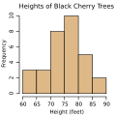
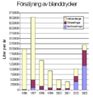
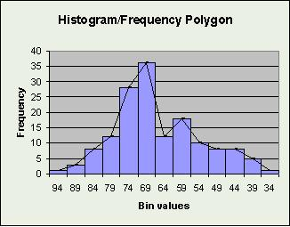
Histogram:
Bar chart:
Frequency polygon

Slide 26
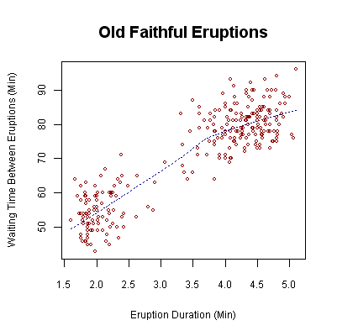


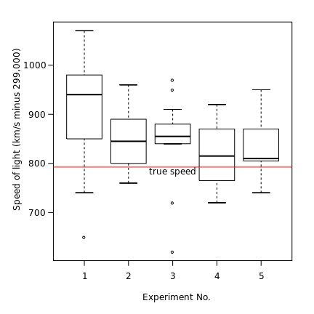
Pie chart:
Scatter diagram:
Line chart:
Box plot

Slide 27
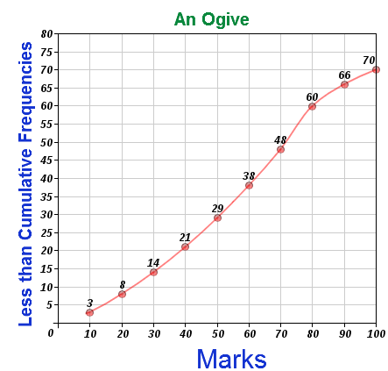
Cumulative frequency polygon or ogive

Slide 28
Thanks

